Slide 1


Slide 2

3PO BASIC
Part 1

Slide 3
3PO MECHANICS
There is one game, three referees, but still only one officiating team.

Slide 4
modules
R3.9 Out-of-Bounds & Throw-Ins
R3.10 Shot Coverage
R3.11 Rebound Coverage
R3.12 Reporting Fouls & Switching
R3.13 Last Shot
R3.xx Free Throws (not in the HSB)

Slide 5
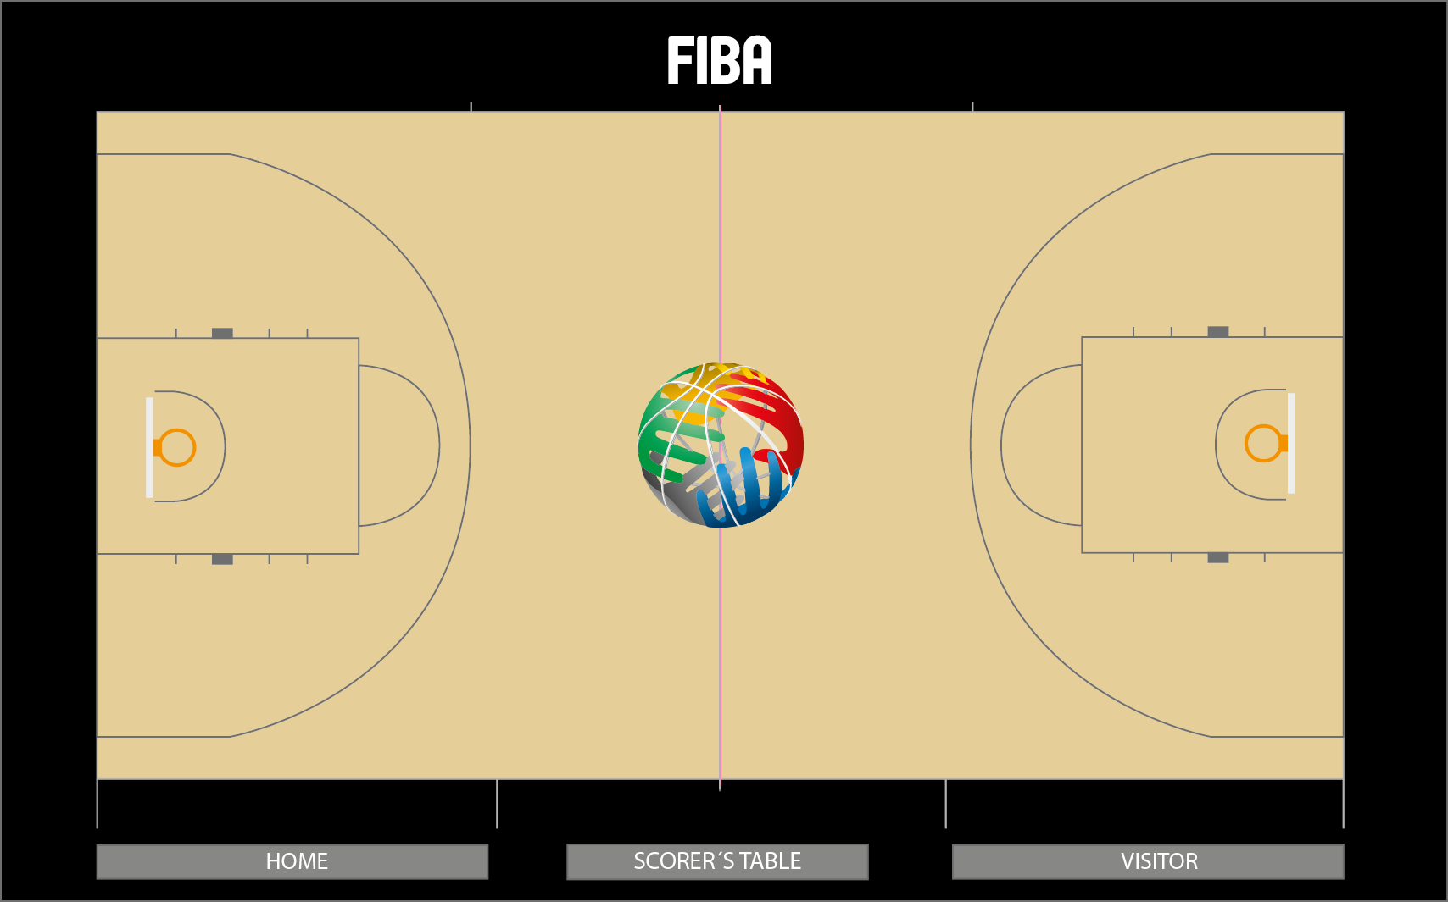



Half court coverage / lines
HSB / page 208

Slide 6
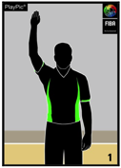

SEASON 2015-16: throw-in frountcourt endline
HSB / page 208
A) Lead (active referee) outside (basket-ball-referee)
B) Trail mirrors the time-in signal from Lead

Slide 7
SEASON 2015-16: throw-in frountcourt endline
HSB / page 208
A) When throw-in in the corner
B) Lead (active referee) inside (basket-referee-ball)
C) Trail mirrors the time-in signal from Lead

Slide 8
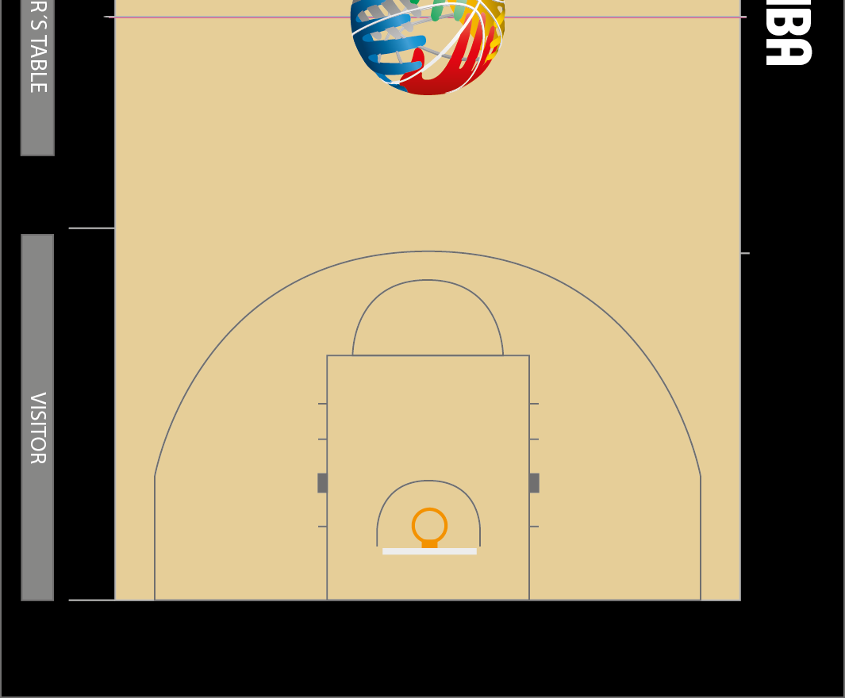

Center & trail – dual coverage
HSB / page 209
Notes:
ME-02_C_inital position_next movement and play
MC-01_L_too narrow angle_C should wait and see if L makes a call.
ME-04_C_primary coverage
ME-06_C_primary_should step onto court
ME-08_C_cross step_too late-fast_moving when action_misses foul

Slide 9
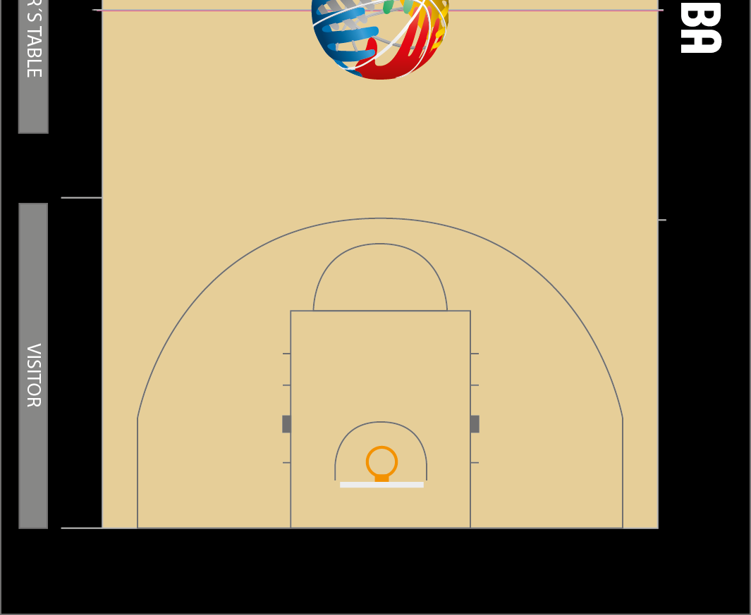
Shot coverage
Dual coverage
HSB / page 209
Notes:
FIBA
ME-11_L_time_distance_
stationary_referee defence
ME-15_Afrobasket_L+C_ distance and until end of action
ME-21_new L too slow in transition

Slide 10










3PO basic:
Rebound coverage
HSB / page 210-2112
1-2 active match-up per referee
Challenge: pick-up the different match-ups (PGC)
Normally 1 match-up can be ruled-out (not active ⁽¹⁾)
⁽¹⁾

Slide 11

Fouls / switch - foul on the frontcourt
HSB / page 213
Double whistle by center & trail
Referee on the opposite side reports the foul

Slide 12
Fouls / switch - foul on the frontcourt
HSB / page 213
Double whistle by center & trail
Referee on the opposite side reports the foul

Slide 13
Fouls / switch - foul on the backcourt
HSB / page 214
NO LONG SWITCHES
Foul on the opposite side by center

Slide 14
Fouls / switch - foul on the backcourt
HSB / page 214
NO LONG SWITCHES
Foul on the table side by center

Slide 15
Fouls / switch - foul on the backcourt
HSB / page 214
NO LONG SWITCHES
Foul on the table side by lead

Slide 16
Fouls / switch - foul on the backcourt
HSB / page 214
NO LONG SWITCHES
Foul on the opposite side by lead

Slide 17
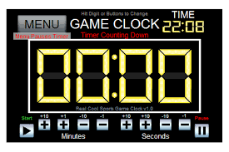

3PO basic:
Last shot – opposite side referee
Normally referee on the opposite side is responsible
For the last shot and signal

Slide 18
3PO basic:
Last shot – table side referee
BUT IF referee is engaged with another play, in which case the referee on the table side is responsible for the clock.

Slide 19
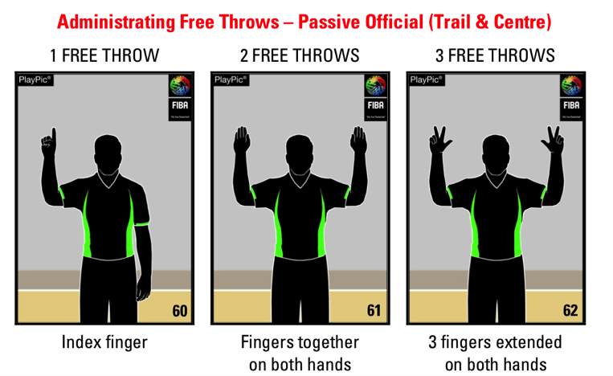
Free throws – passive official
2po
3po

Slide 20
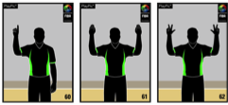
3PO basic:
Free throws – passive official
Signals – center ONLY indicates number of freethrows

Slide 21
3PO basic:
Free throws – poSItions & COVERAGE
Normal positionS:
free throw to be followed more free throw(s)

Slide 22
3PO basic:
Free throws – poSItions & COVERAGE
Normal positionS: Last free throw

Slide 23
3PO advanced: Free throws
poSItions & COVERAGE
Last free throw - players in the new fronT court
trail adjusts towards to the new front court
(position depends on the number of the players in the frontcourt & time of the game)

